Slide 1

Administrative Meeting, 2/26/18
Melissa Roy

Slide 2
Overview
49er Mart
  Adding an address
  Exporting reports
Travel
  Rental Car process
  Tips and Gratuity
  Meals
  Mileage reimbursement on personal vehicle
  Travel Forms

Slide 3
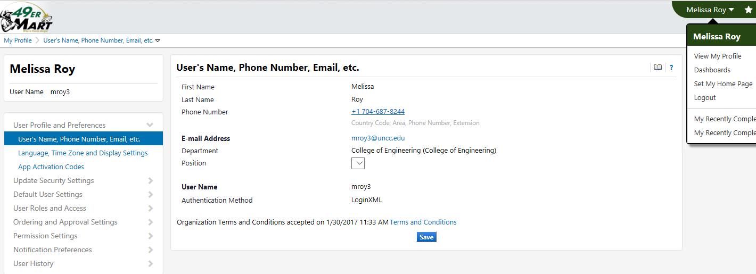
49er Mart- Adding an Address
Click on drop down arrow next to your name and select View My Profile.

Slide 4
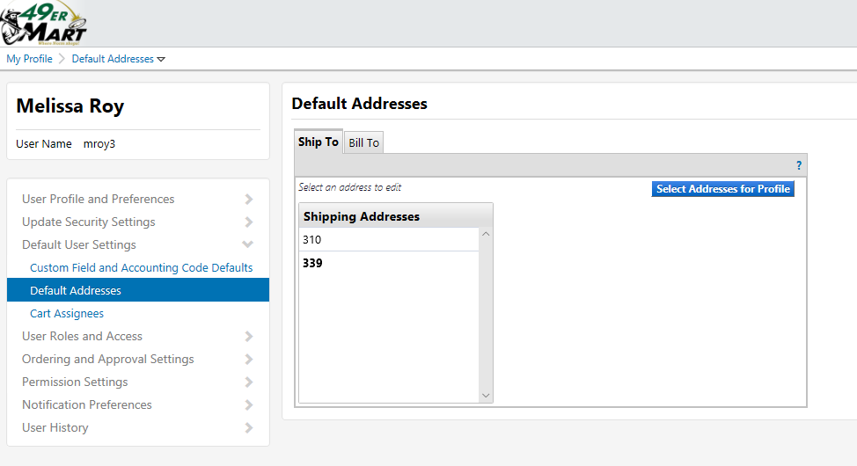
49er Mart- Adding an Address
Under Default User Settings, Select Default Addresses.
Click the Select Default Addresses, click on Select Addresses for Profile.

Slide 5
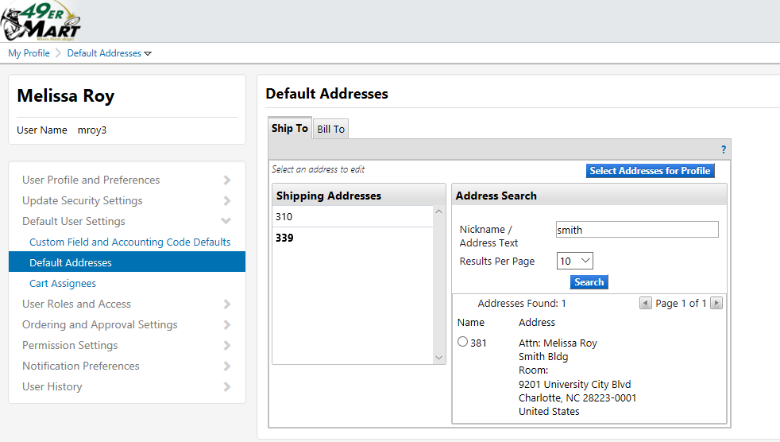
49er Mart- Adding an Address
Type the name of the building in the Nickname / Address Text field and press the Search button.
Click the bullet beside the correct address.

Slide 6
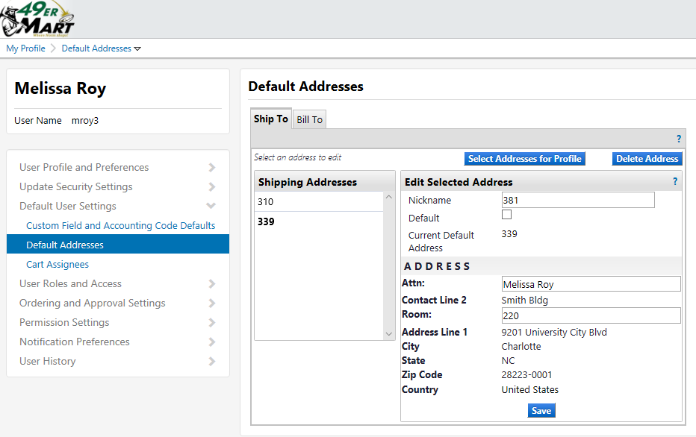
49er Mart- Adding an Address
On the next screen, enter a Nickname for this address and check the Default checkbox to make it your default address.
Enter a name in the Attn: field and a number in the Room: field (if goods will always be shipped to the same room).
If a field is left blank, it can be added in the cart when checking out.

Slide 7
49er Mart - Reports
Search for the information you want to export

Slide 8
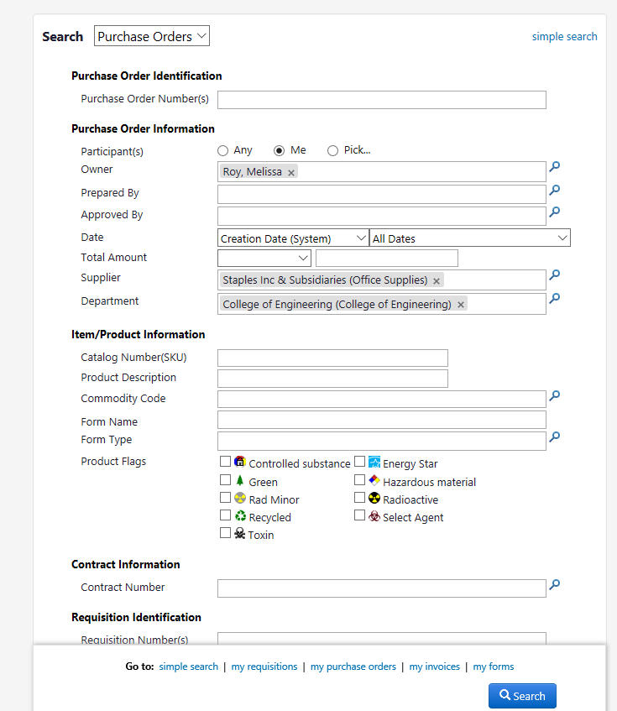
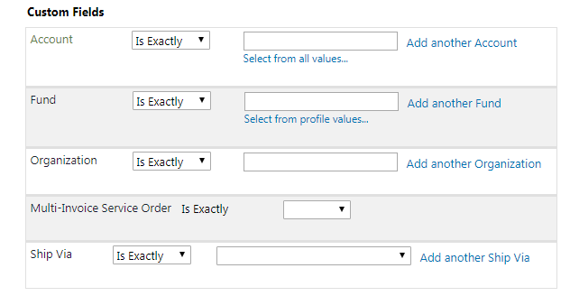
49er Mart - Reports
Search for the information you want to export

Slide 9
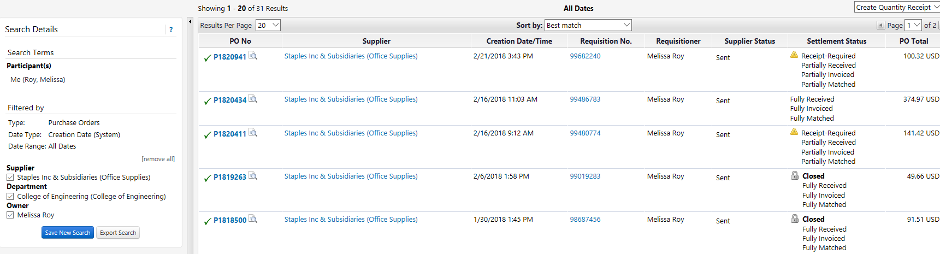
49er Mart - Reports
Click on Export Search

Slide 10
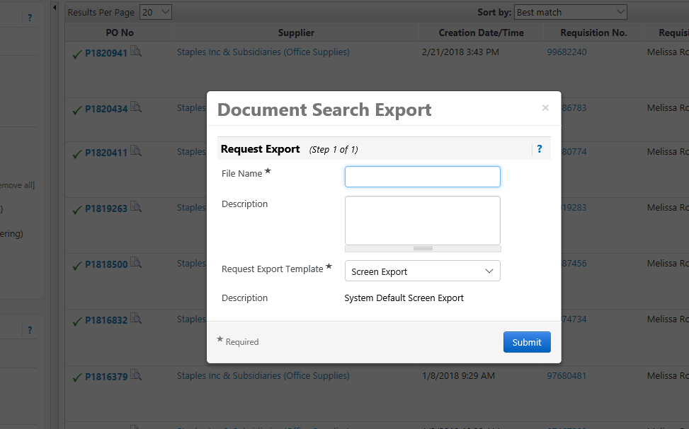
49er Mart - Reports
File Name and click submit
To view file:

Slide 11
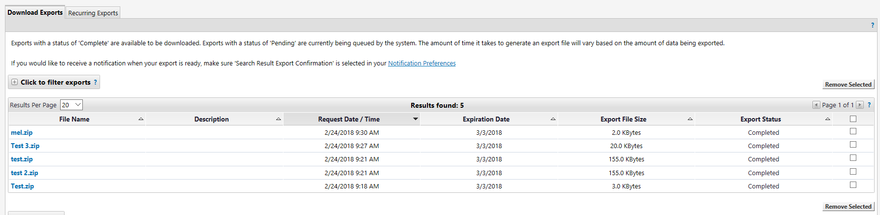
49er Mart - Reports
Click on report you want to view

Slide 12
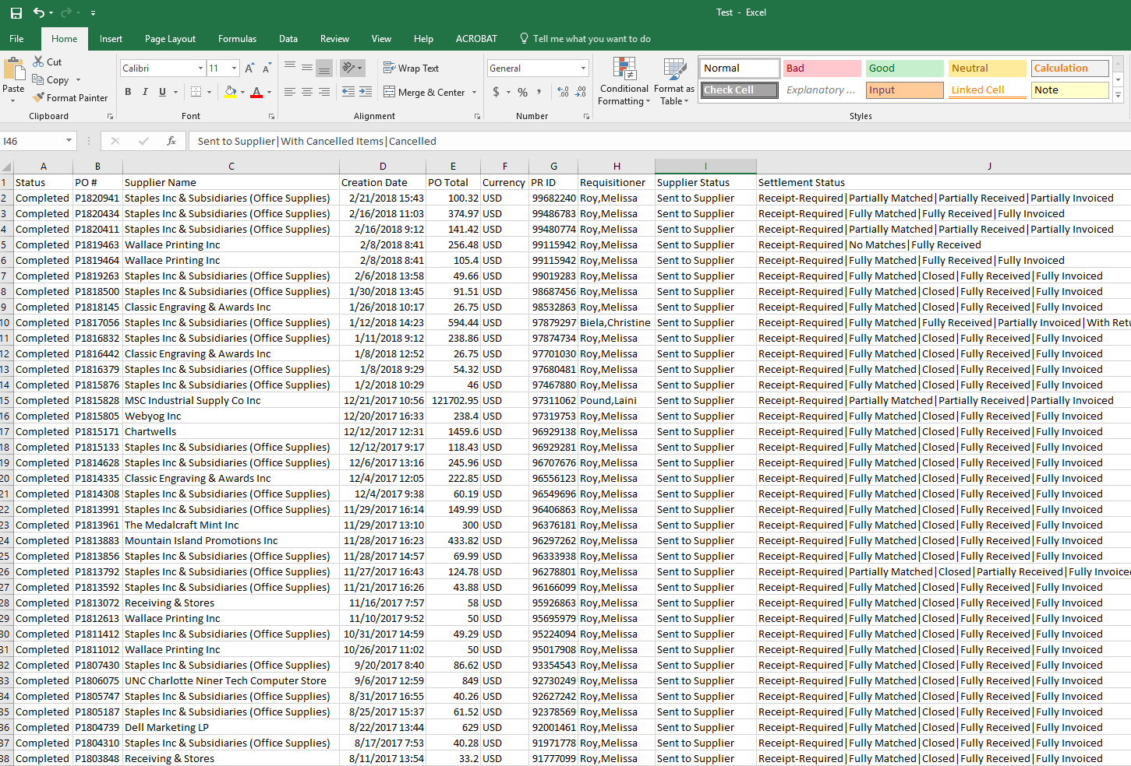
49er Mart - Reports
Example Report

Slide 13

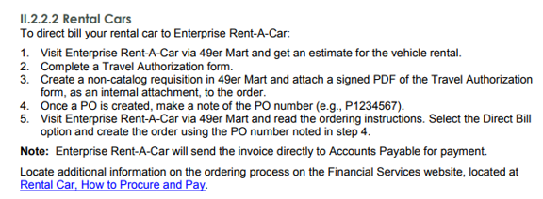
Travel – Rental Car
  P-card
  Personal credit card
  Direct Bill

Slide 14
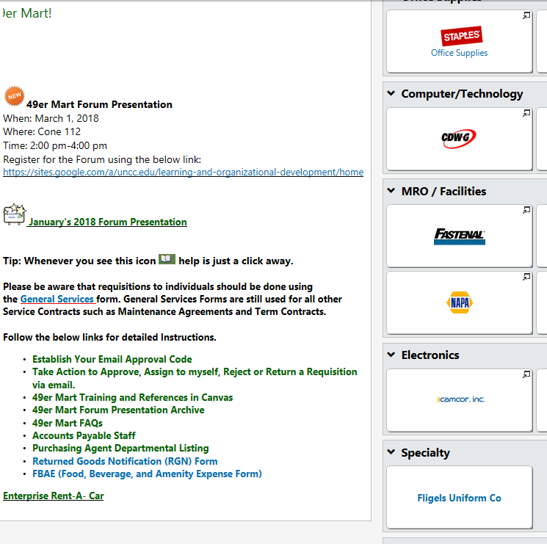
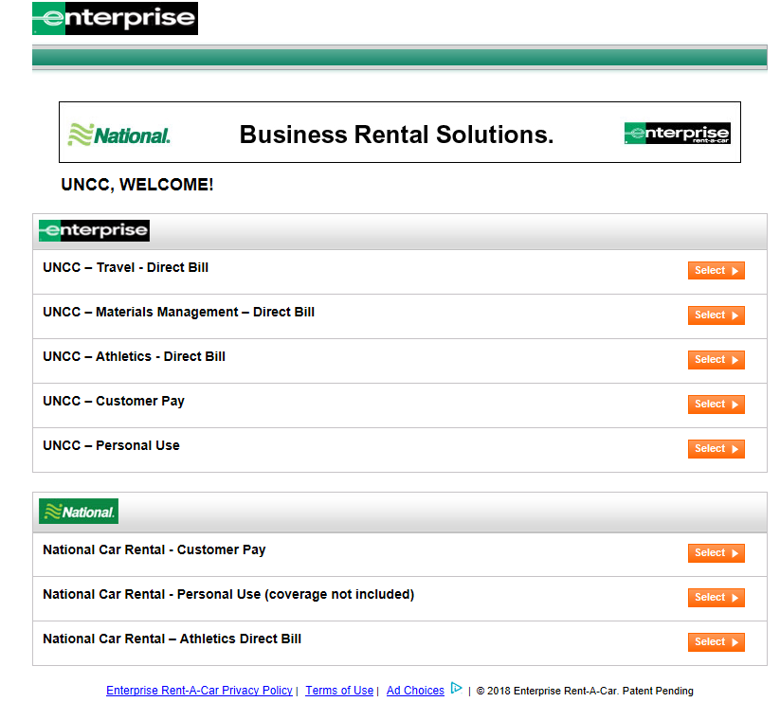
Travel – Rental Car
1. Visit Enterprise for quote

Slide 15
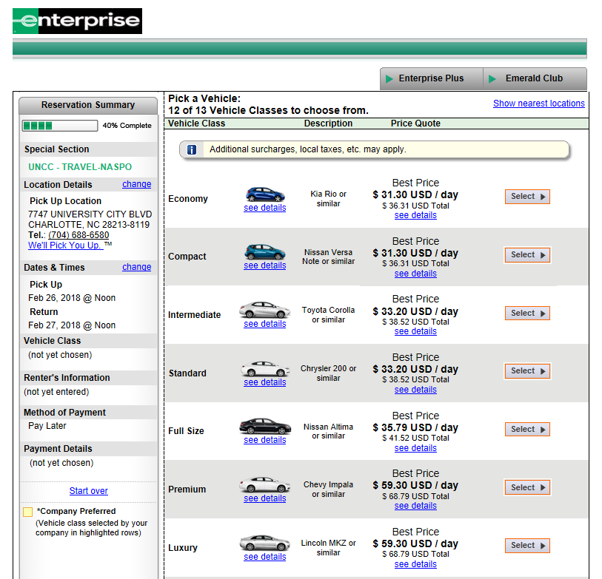
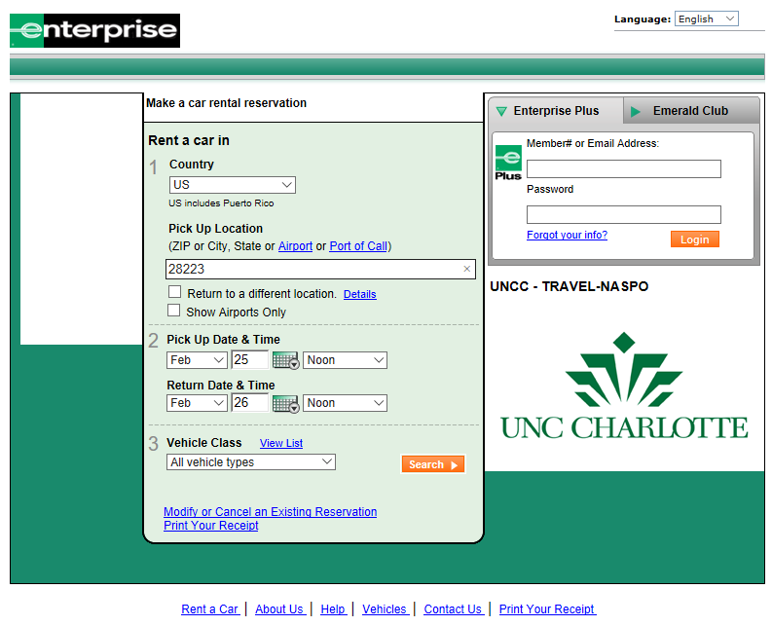
Travel – Rental Car
1. Visit Enterprise for quote

Slide 16
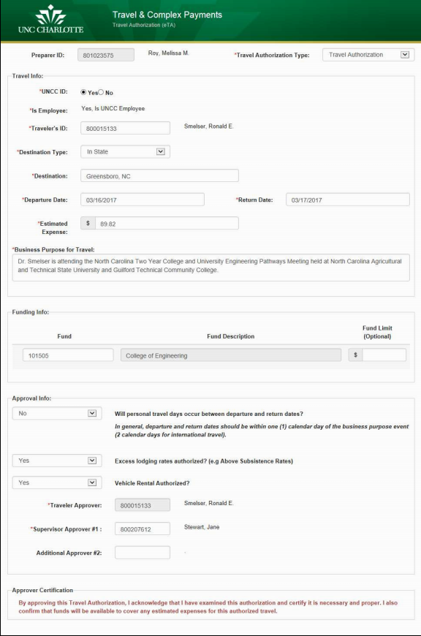
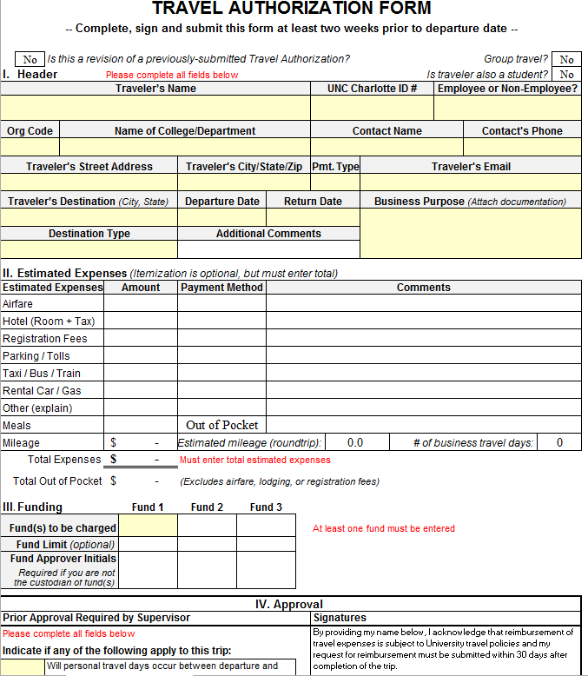
Travel – Rental Car
2. Complete Travel Authorization

Slide 17
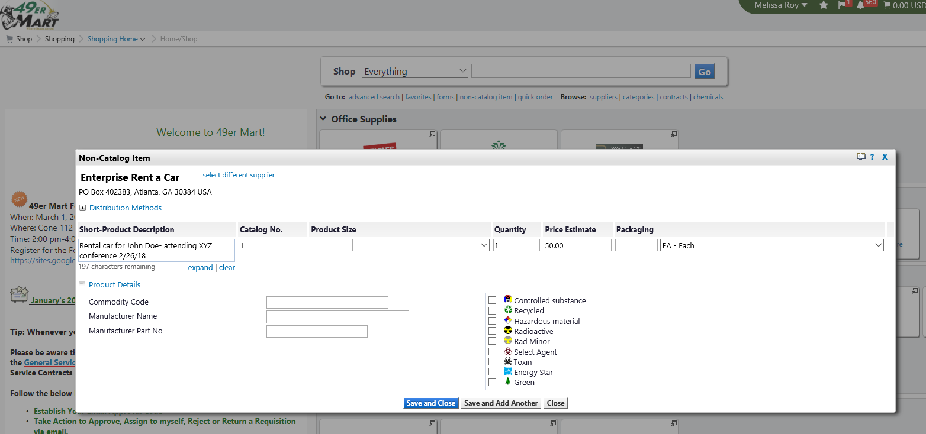
Travel – Rental Car
3. 49er mart non-catalog item
4. Make note of the PO #

Slide 18
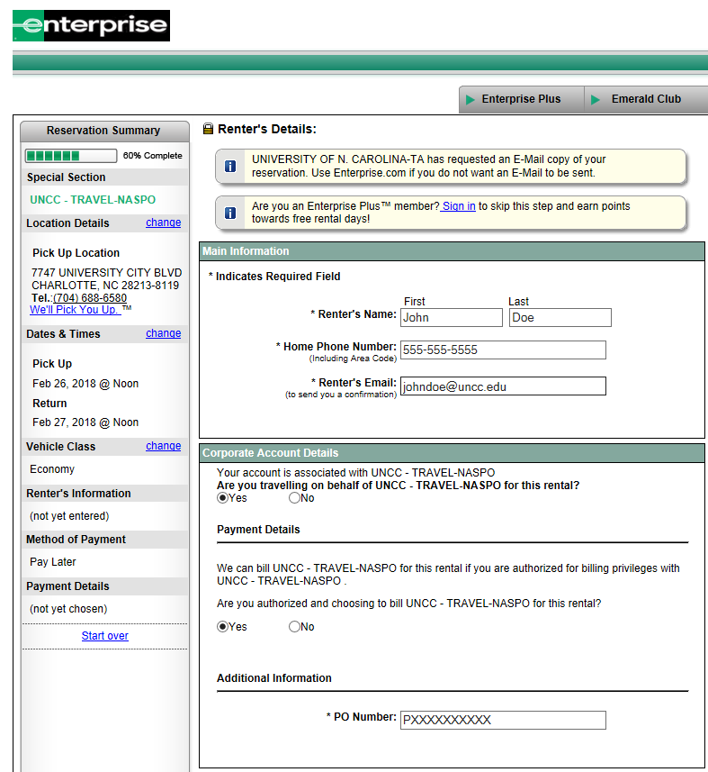
Travel – Rental Car
5. Book with PO #

Slide 19
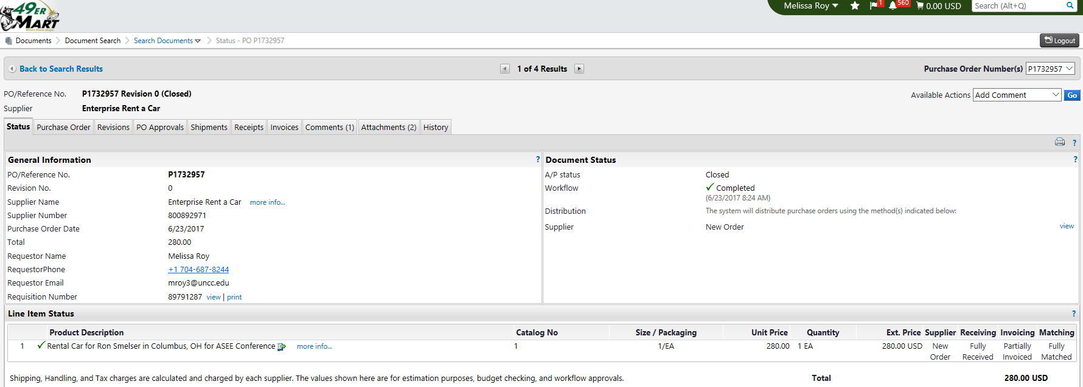

Travel – Rental Car
Receive the PO when travel is complete for payment

Slide 20
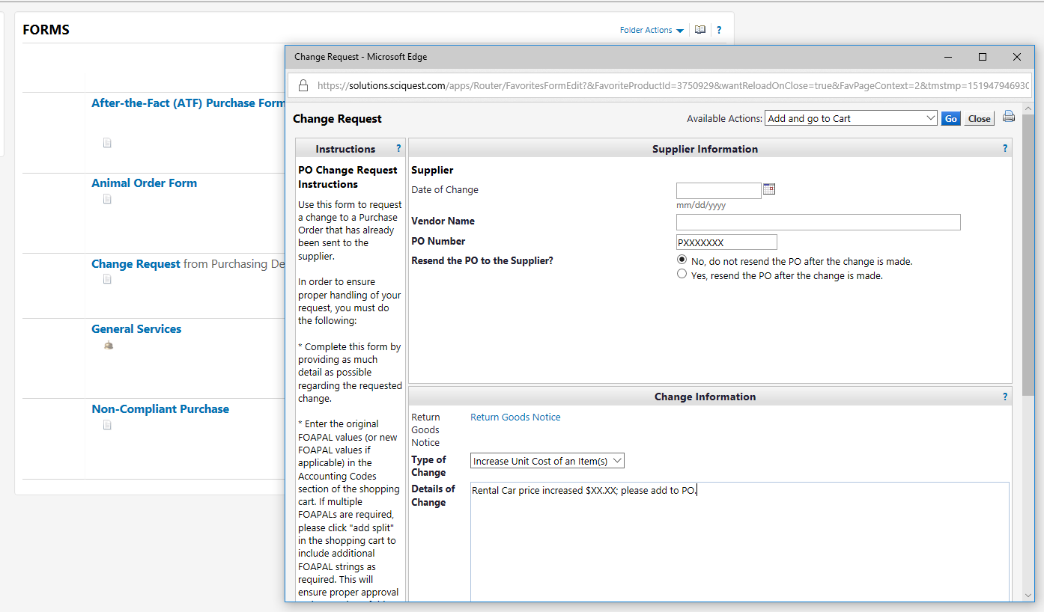
Travel – Rental Car
If over amount of quote will need to complete a change request

Slide 21
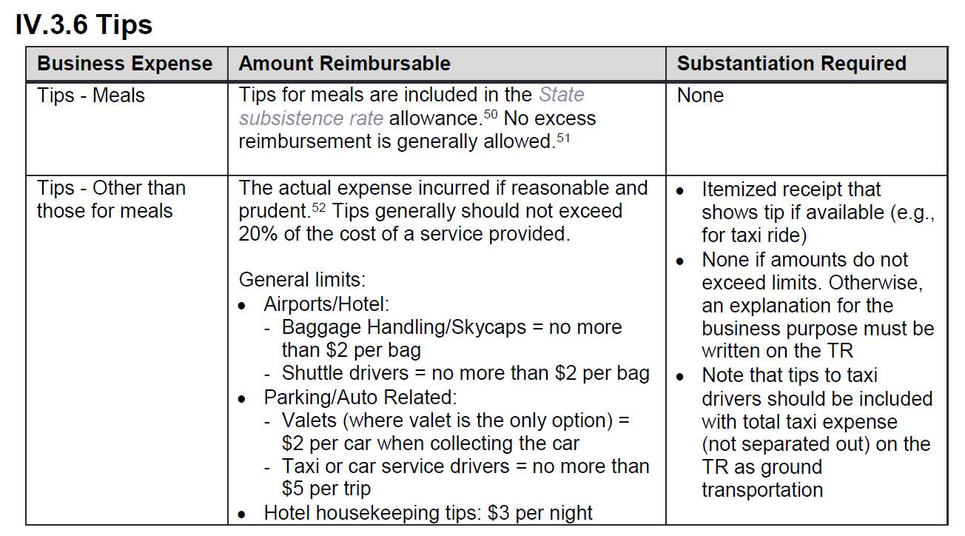
Travel – Tips and Gratuity
Taxi or car service drivers: no more than $5 per trip

Slide 22
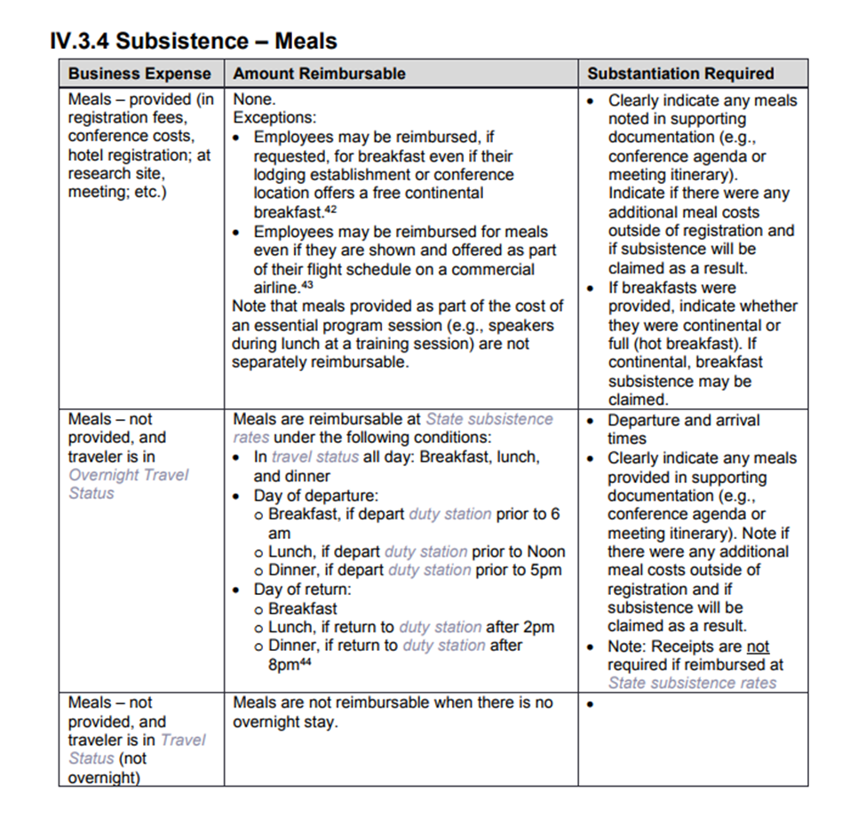

Travel – Meals
Meals are not reimbursable if there is no overnight stay.

Slide 23
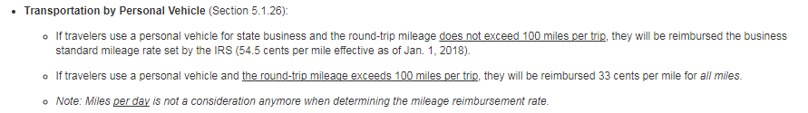
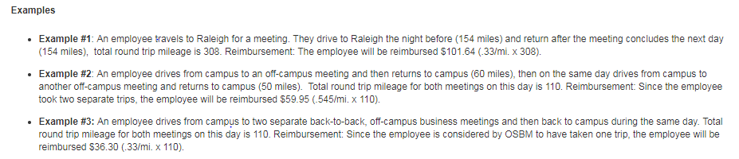
Travel – Mileage reimbursement

Slide 24
Travel – Forms

